Slide 1
University of North Carolina –Asheville’
International Collaboration Workshop
Notes:
Pre-introduction visual that is up.
Excited to be here with you for the next 2 hours

Slide 2
Understand COIL:
Collaborative On-line International Learning
Technology Tools
Common pitfalls, solutions
Resources to execute
Notes:
Here is what I want us to get out of our time together. These 4 things.,
I will focus on How, more than why, because you are already part of cohort to internationalize curriculum.
Will go over key tech tools (live video conferencing, (and practice this in the afternoon) Facebook, student produced video
Common challenges and solutions
Resource Kit to use.

Slide 3
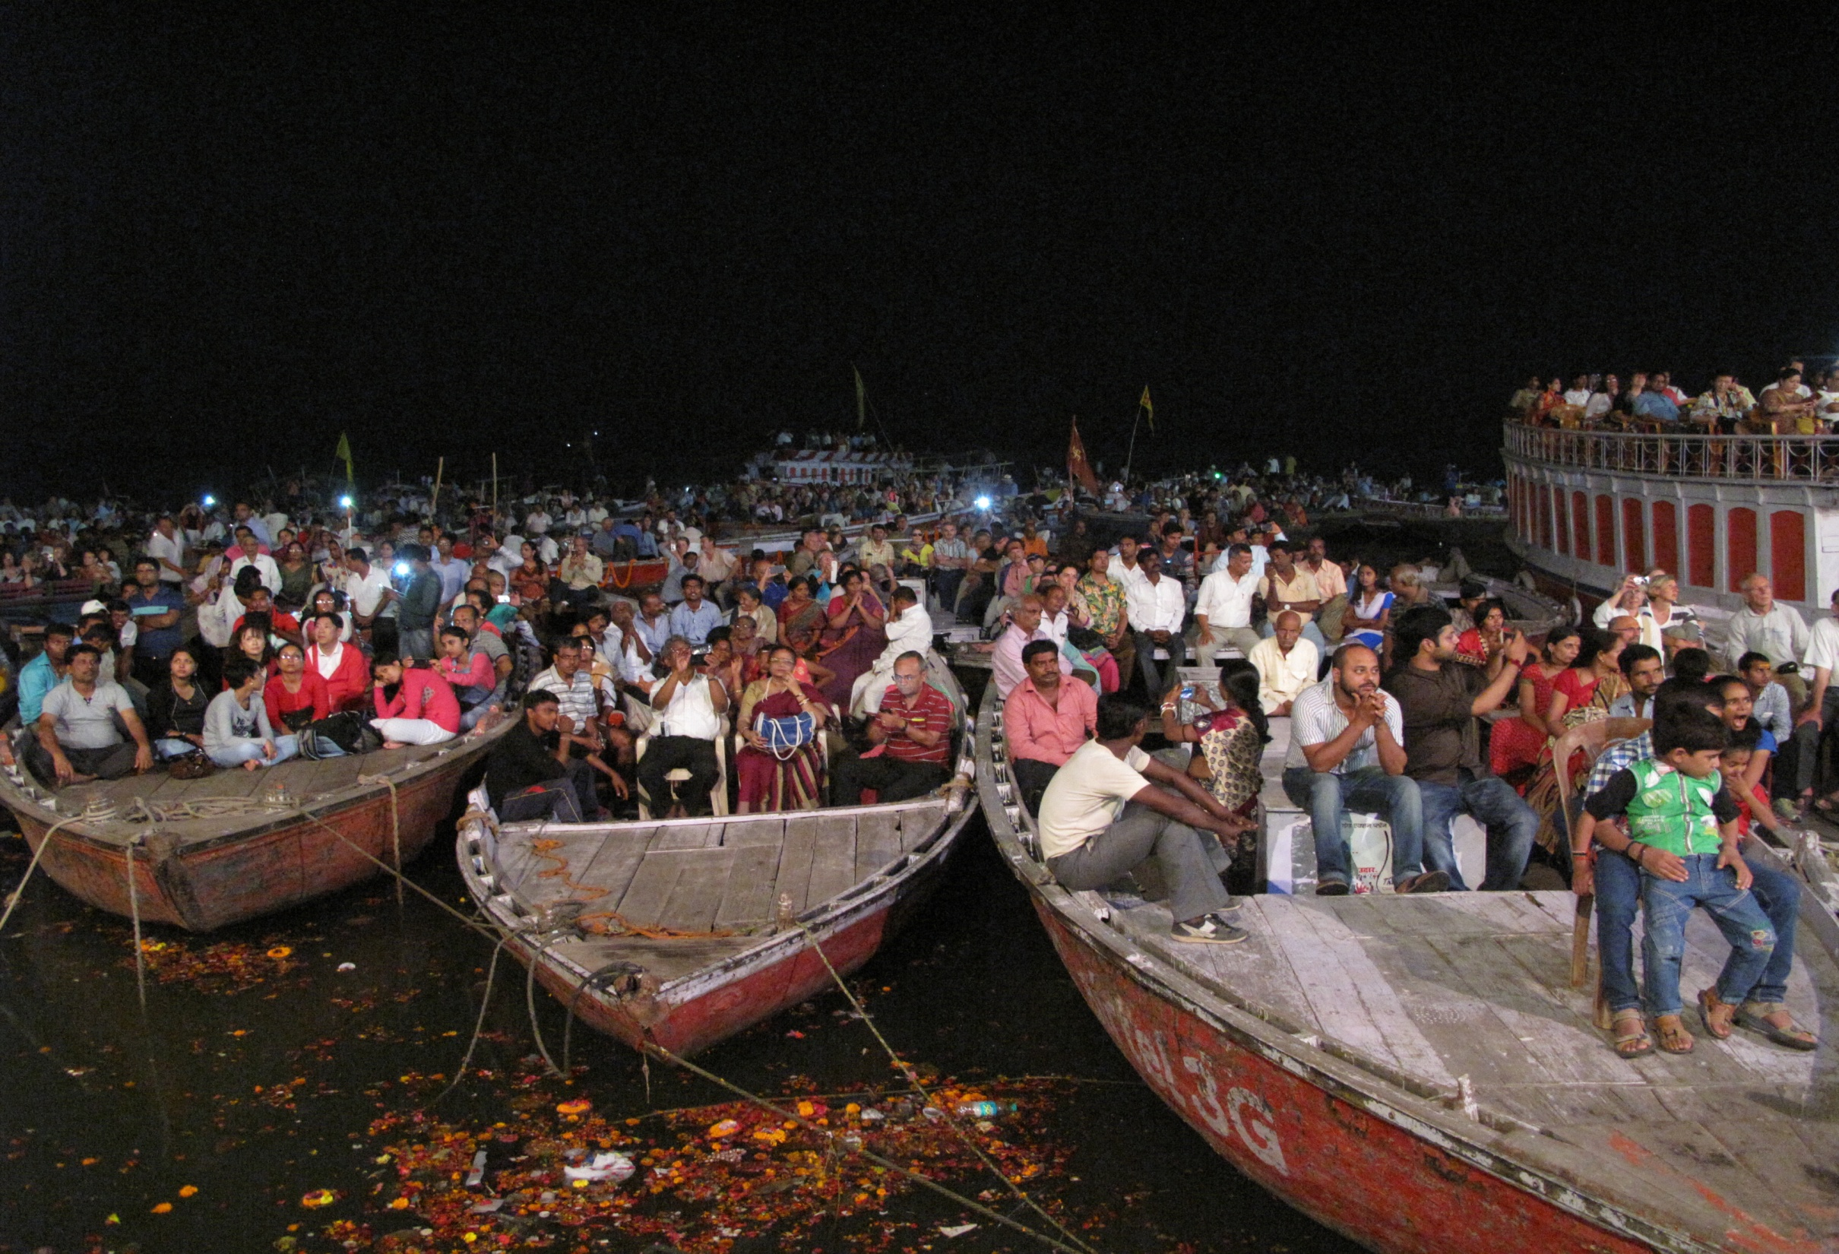
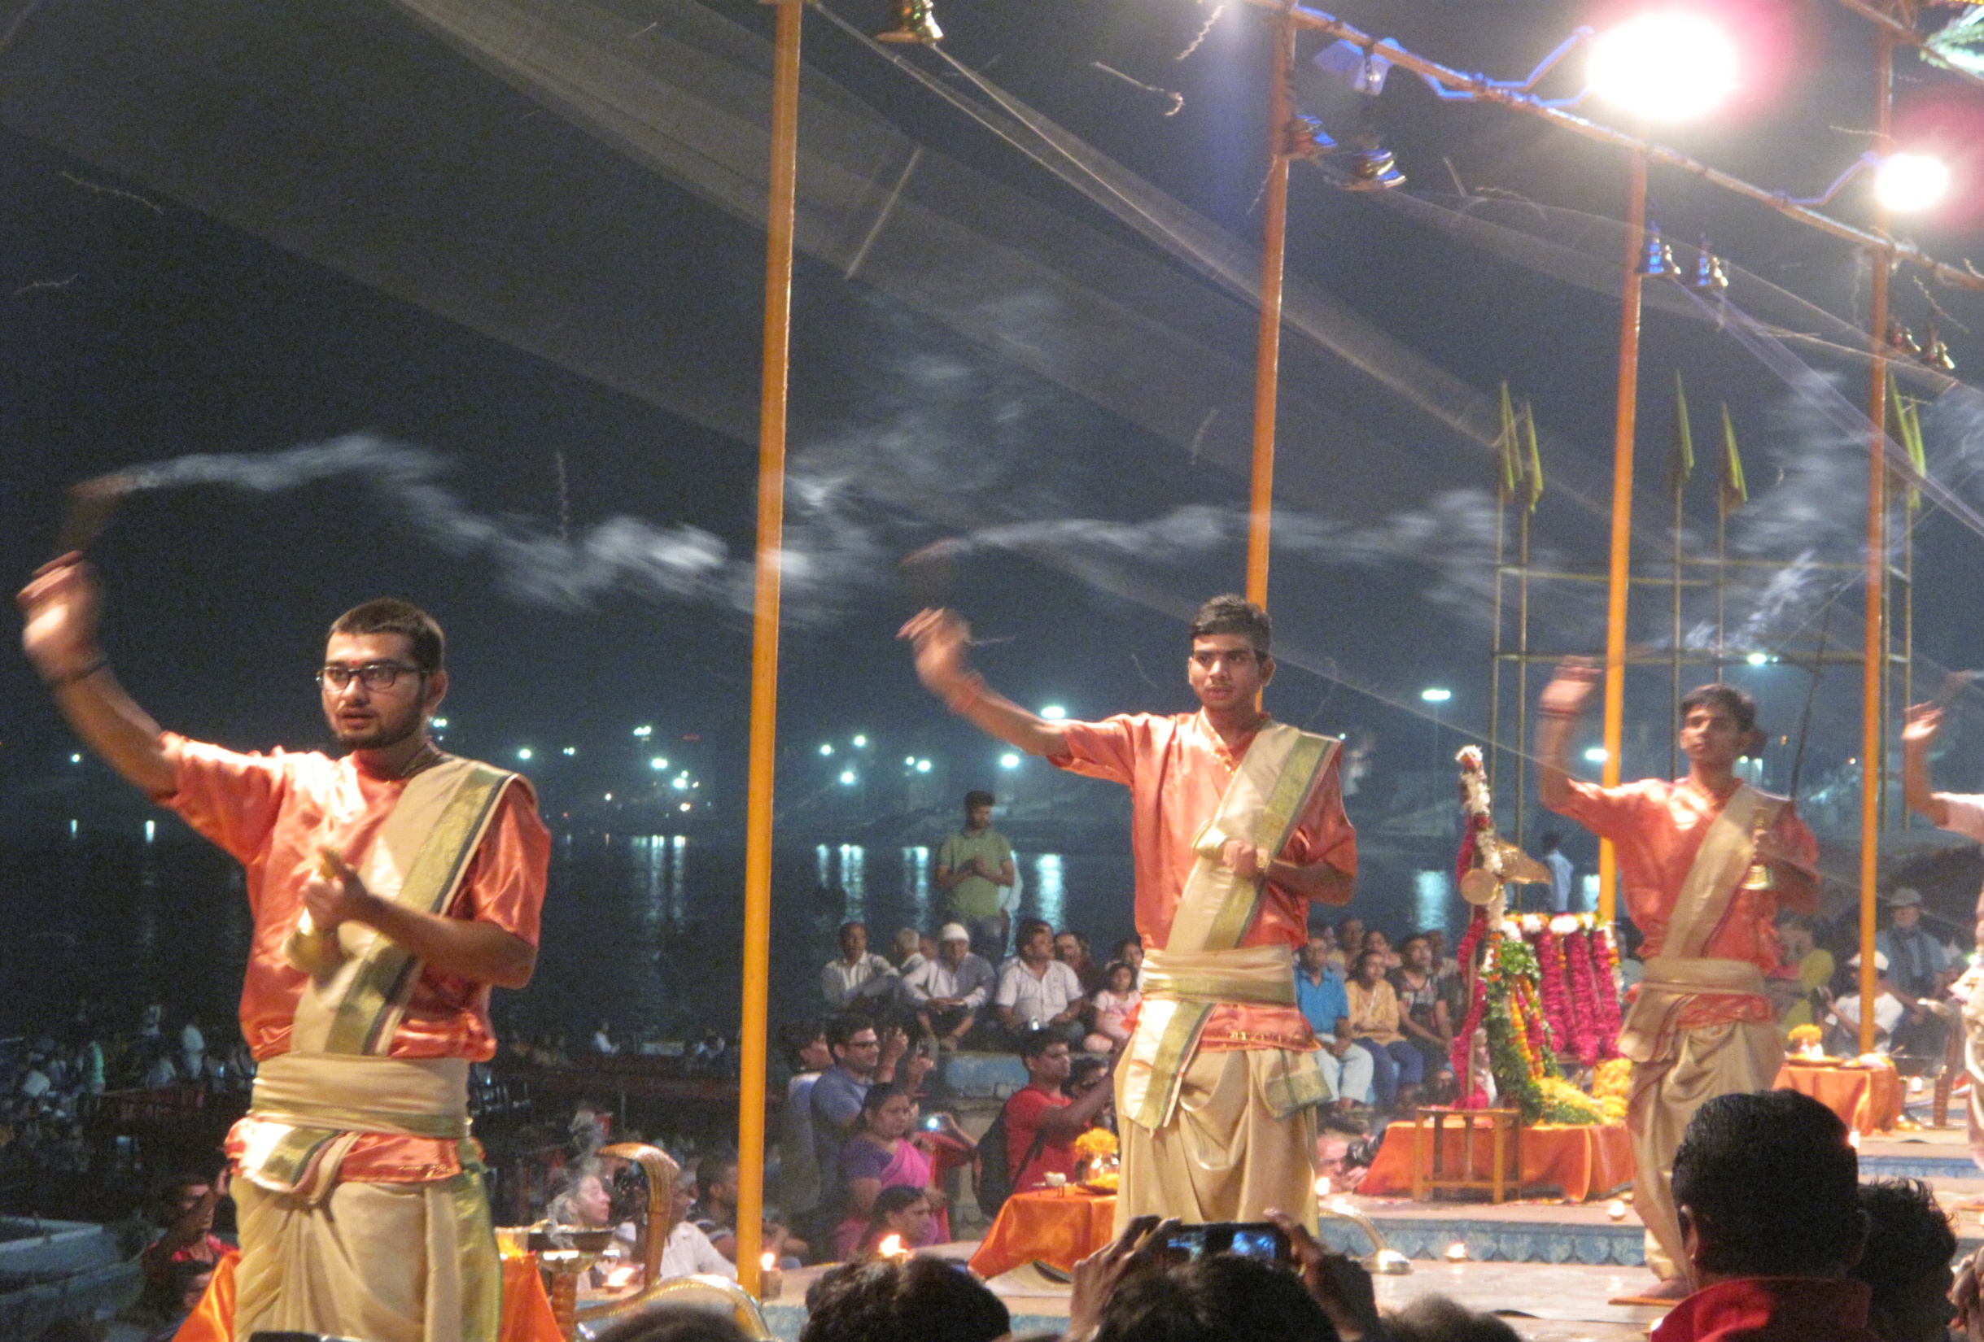
Greg
Tuke
Notes:
Greg Tuke.
From Washington State. Not be be confused with Washington DC, nations capital on other side of country. What we call “the Bad Washington”. We are the “good Washington”! Home of Bill Gates and Microsoft, the Space Needle, Boeing airlines and Starbucks coffee.
Like any traveler, we find lots of unexpected similarities, and unexpected differences! (CLICK).
And as was mentioned in my introduction, I have been working in the field of education for most of my career. But the last 10 years, I have focused on international collaborations within the education field. I have done this because I am convinced we need to make big changes in the way we teach to prepare students for the global world they now live in. I have worked with students in Iraq, Jordan and Egypt and Gaza, as well as in Central and South America. And I have traveled and worked with students in Africa. In each country, it is the same. Few of us are learning together across countries and cultures, and unless we change that, we are sending students out very unprepared for the world they now inhabit.
If we want to empower women to be leaders to make the world a better place, we need to provide learning experiences that get them interacting and problem-solving with the world, NOW.

Slide 4
INt
Introduction, course idea, challenges
Notes:
WHAT is COIL?
We want our global brain to not only be connected, but to operate effectively and efficiently with our Global Brain network. And that is where cross cultural communication skills come in. because our global brain network is made up of a lot of other brains (and hearts) that operate a little differently than ourselves.
Its kind of like a MAC user trying to use a PC. Unless you work at learning how the other system operates, and don’t assume its just like a MAC, you really can’t tap into its genius.
Introductions: So to begin, let’s start but allowing all of us a peak at your own brain, and hear from each of you: introduce self, course you have in mind,

Slide 5
Collaborative
Notes:
Collaborative: in the classroom, and with your international partner. Often form small global teams, 2-3 for each side, for a group of 4-6
Here is an example from Tibetan students who worked in one of the small global teams on immigration issues.
Note that they are getting info from primary sources here, in some cased people who have had personal experiences with immigration issues.
Also worth noting that you learn as much about yourself and your own country in these dialogues, because you must explain your country to others
And note that if done well, it becomes personalized. No longer “The Tibetans” or the Americans, its specific people you get to know.
Unique Learning.
Students do things when you teach in this way that you don’t often see. Here are some sample clips from two recent courses we did this fall. Notice a few things:
Students are studying about the issue in traditional ways (readings, lecture), but then they have an opportunity to go to primary sources for verification of facts, and for a deeper look at what the facts mean. They are asking each other questions, and trying to dispel prior assumptions. And, they are making real, heart-felt connections, not some text-book fact. It’s personal, and therefore more powerful learning.
In our projects, we look for students to connect from both the head and the heart. See if you think that happened here… (show video)
Link: https://www.youtube.com/watch?v=4DJApONvhII&feature=youtu.be

Slide 6
Virtual
Unique learning
Notes:
Its On-line, or virtual
Students communicate in various ways: synchronous, like this in a live video conference, or live chat on facebook, Whats up
Or asynchronous, on Facebook, or a recorded student-produced video clip.

Slide 7
International
Notes:
First, its international. These are students in Egypt we worked with, connecting to US students, and usually it’s a two partner collaboration, but not always. I will show you an example from a partnership between Egypt, Morocco and the US. I have even seen 10 partners in a collaboration, but commonly its just two.

Slide 8
Unique learning
From the field
Notes:
Show Seattle U video. Give introduction of global teams.
https://www.youtube.com/watch?v=obz6Wlyi86o
So, I now want to show you a video I made with students a couple years ago, that I hope will convey the impact these kinds of courses have on students.
Some background
It’s a three country collaboration: Egypt, Morocco and US
The students divided up into global teams, two countries represented on each team, for a total of 5-7 students on a team
Each team worked with a local NGO, who gave the team a real-world problem they were concerned with.
The video focuses on one team in particular: the US-Morocco team. There NGO was a job-training program, training Moroccans to be “call-center employees”, a good job in Morocco, well paid. The NGO had a good in-person training program going, but it was costly to them, so they had developed a training program that could be delivered on-line, and for a lot less cost. But they didn’t know how they could effectively recruit young people to the site to get the training. So they asked our global team to come up with a marketing strategy. Here are some scenes from how it went… (show video)

Slide 9
70%
Notes:
Where 70% of our communication is done virtually in the workplace. How do we do that effectively?

Slide 10
Business requires it

Slide 11
Required: Virtual skills
Cross cultural skills
Notes:
Not only is it virtual, but increasingly global and across cultures.
So at WCA, you have the courses to careers program and degree-plus. This is essential learning for being successful in the workplace of today. It is not the same as face to face, and those of us who have worked with folks from other cultures, learning styles, its essential to have the mental flexibility and adaptive skills to do it well.

Slide 12
Global solutions requires global teamwork
Notes:
The think is, learning to understand each other across cultures by developing communication skills is nice, we can get along better, but in today’s world it is a requirement.
Climate change. No one country can solve this problem and it will dramatically impact us all. But its not just climate change. In fact, most of the major problems we face in our local communities: clean water, clean air, a vibrant economy, adequate food, cannot be solved just locally. And the best solutions can come from using our global brain. I will return to this topic in a few minutes.
So students need practice now in solving problems through global action teams, working now with people from around the world. Or else we wont get the job done.

Slide 13
Course Themes
Communications (Global Networking, Comic Journalism)
Sociology (Social Movements/ International Lens, US/Japanese pop. Culture)
Introductory Core (Intro to writing, research)
Health (Policies, Politics)
Media (Social Media and Global Change)
Political Science (South Africa culture and Mediascapes)
Technology (Video for social causes)
Environmental Studies (Peru and US bioregions)
Business (Social entrepreneur training)
Notes:
Some say this makes sense for international studies, but don’t see relevance to other degrees. But, just as all kinds of businesses are going global and virtual, our courses preparing students need to embed this practice as well. And at our school, and increasingly more around the country, they are.
Greg reviews how you can apply this to multiple kind of courses… These are some sample courses at UWB now.

Slide 14
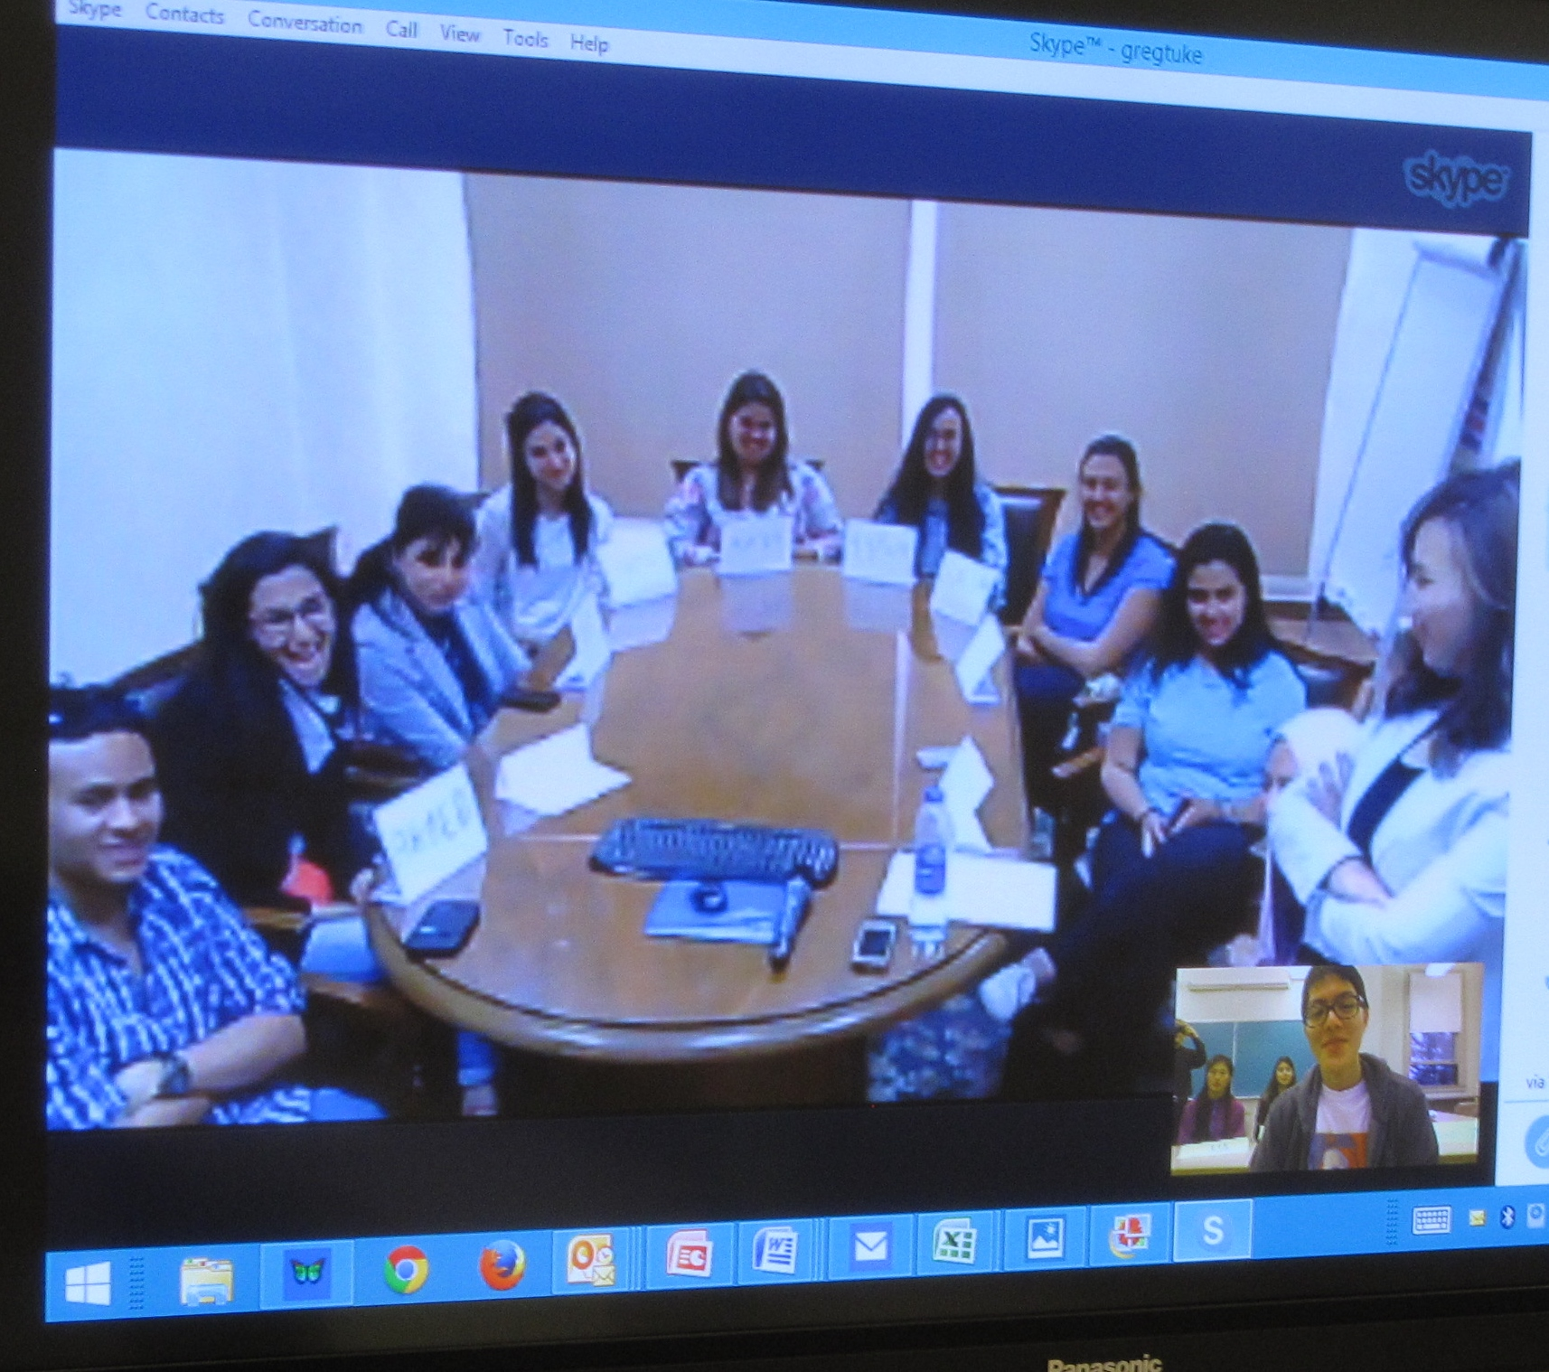
Notes:
Video conferencing

Slide 15
Large group
Notes:
Here is a full class: 20-30, its more difficult. You will see in a few minutes an example of this in a video clip, from UNC and CUTS, and will show you a couple excerpts from it showing large group interactions and small group.
https://www.youtube.com/watch?v=wCa4I6THPX0 Go to 2:36 to 3:36
Small group: 6:31-7:40 (transgender

Slide 16
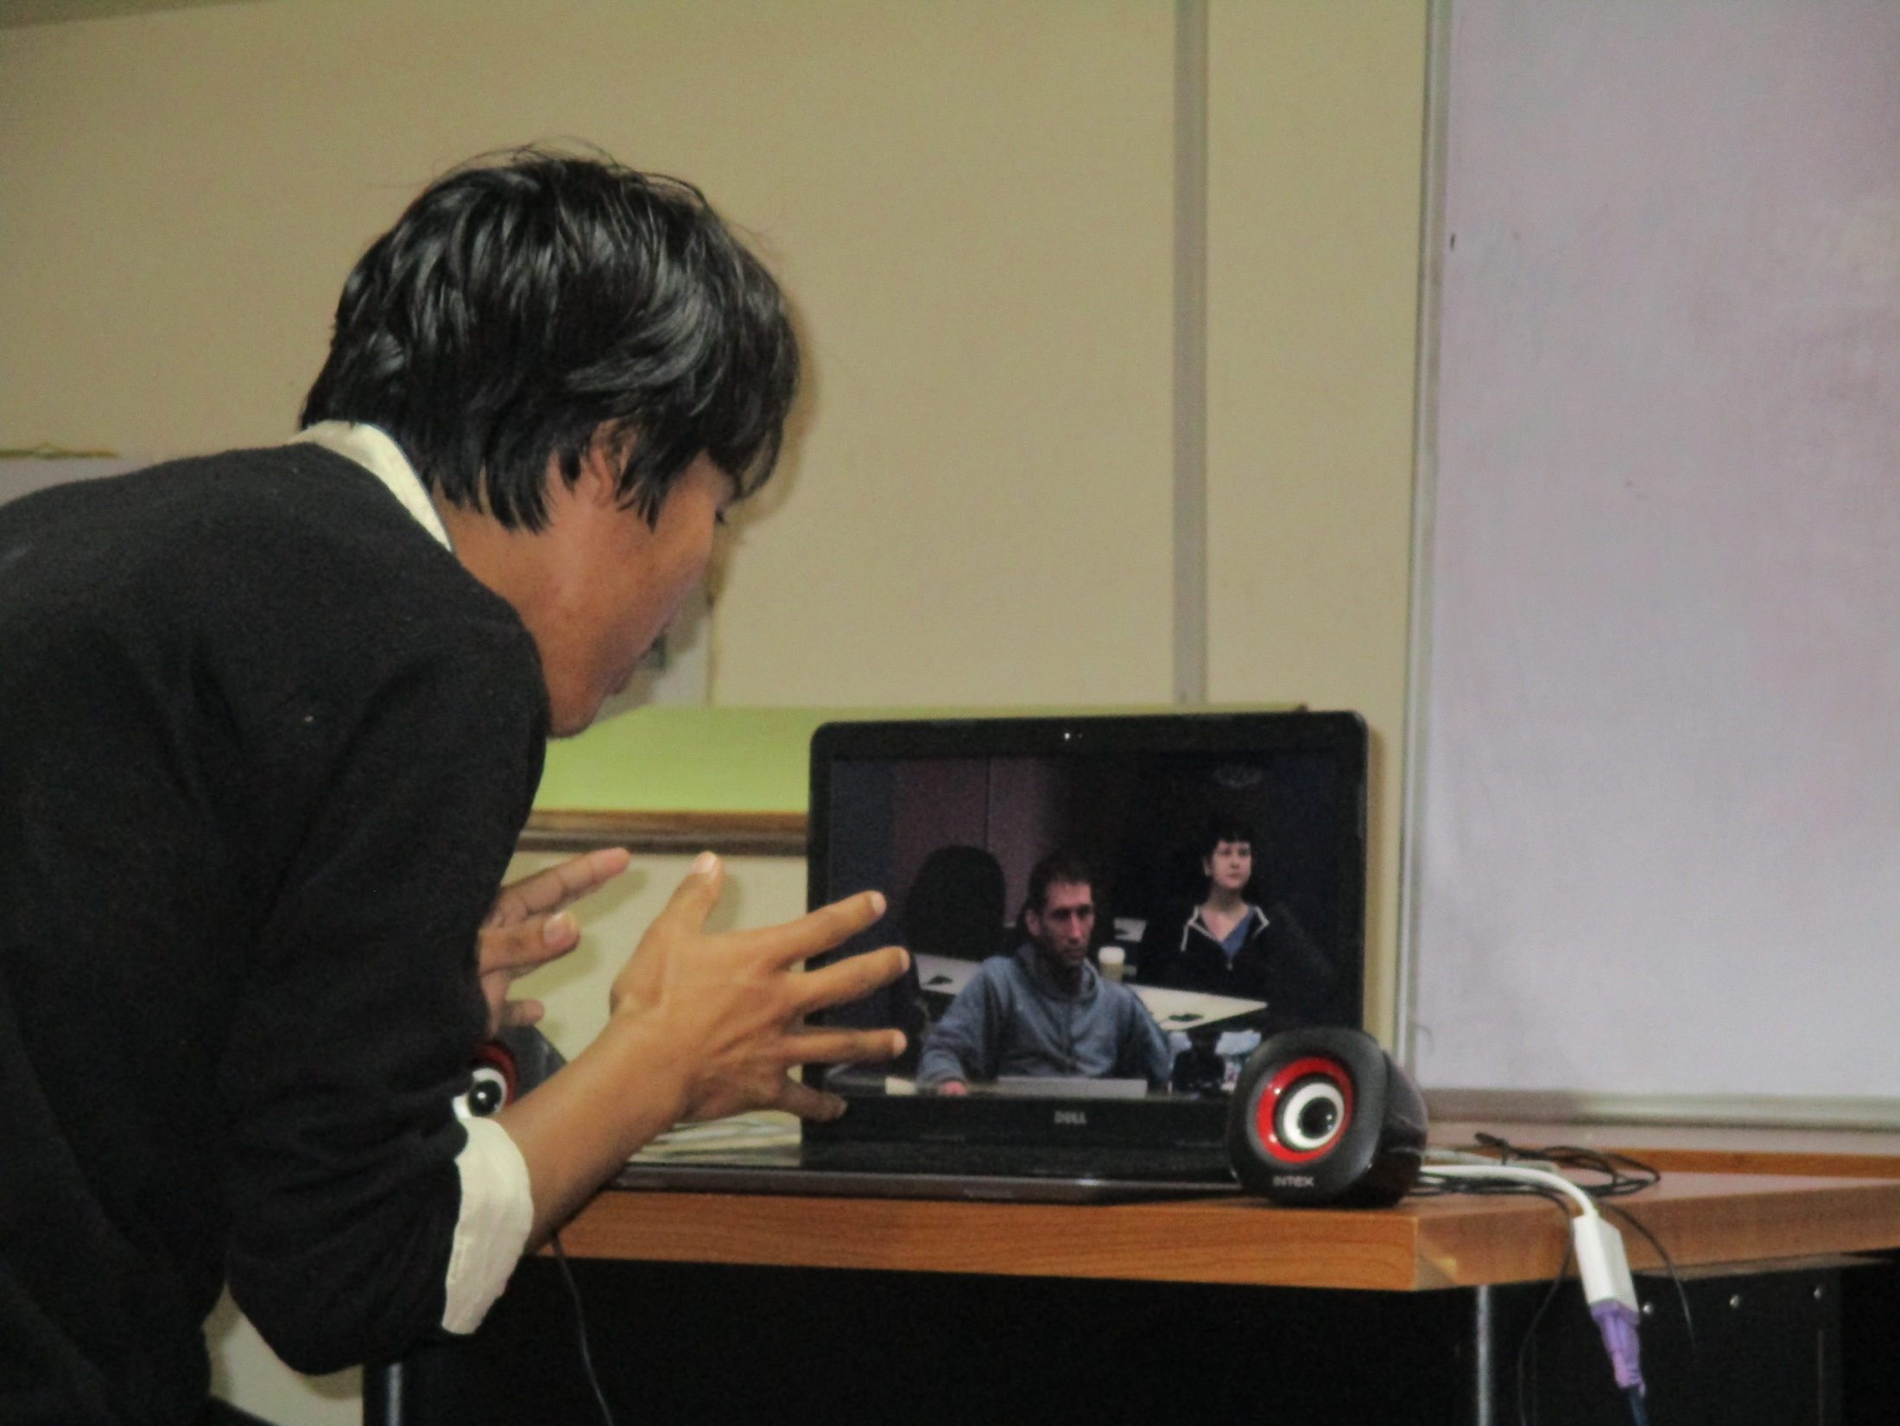
Notes:
Working one to one, or one to two. Calling from home, given time differences.

Slide 17
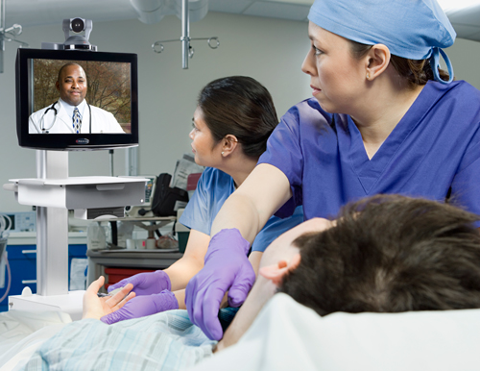
Top 10 video tips
Pre-test
Back up disaster planning
Image matters
Personalize, equalize
Content =King, Audio= Queen
Rehearse
Plan it, don’t wing it
Be nice
Silence is golden-NOT!
Follow up!!
Notes:
Sonia follows this with 15 minutes on “deeper content” techniques

Slide 18
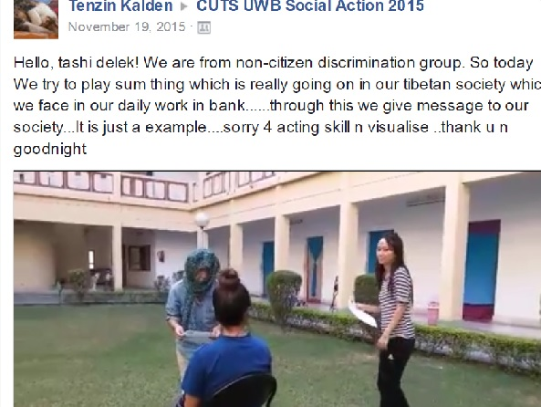
Video 1
Video 2
Notes:
Show the video 1 clip only, tell participants we will touch on this more in the afternoon session
(must have facebook page opened up already to be able to access it first. )
:
Day in the life goofy video: https://www.facebook.com/skylar.lewis.98/videos/979312392106888/
Re-encactment video on social discrimination: https://www.facebook.com/tenzin.kalden3/videos/1058162130913696/

Slide 19
Notes:
Facebook Discussion Groups

Slide 20
Resources
JOIN our Facebook : Fulbright Collaborative Teaching and Research
UW Bothell COIL resources and worksheet:
COIL
Going Global
EDUTOPIA (general resource on innovations in education)
BUCK INSTIITUTE (for project-based learning)
IEARN (k-12 project designs)
GLOBE (science project collaborations)
PROJECT BASED LEARNING TRAINING:
GLOBAL EDUCATION CONFERENCE:
Greg Tuke gregtuke@uw.edu
Notes:
Send this to folks
Student impact on applying lessons: https://www.youtube.com/watch?v=29i2ziu1BpI
Student impact with Morocco/Egypt/US Social Media and Social Change course: https://www.youtube.com/watch?v=obz6Wlyi86o
*BRING UP FACEBOOK GROUP AT END AND HAVE FOLKS JOIN. CALLED Fulbright Collaborative Teaching and Research . Have that printed on paper.
Close the morning session here, asking participants who are coming in afternoon to review and see if you can find anything useful to you that you want to share in the live video conference we will do in the afternoon.

Slide 21
Review
Review
COIL: What, Why, How
Deepening content
Video conferencing basics
Notes:
So, I want to take questions now, but I want to do it in a unique way. I have presented some maybe provocative ideas here, things most of you may never have tried. Usually, we don’t try things for good reasons. You may have doubts about this. That is good, I want to know them. So, I want to ask for your help now, and we will have a discussion.

Slide 22
Response rubric
Notes:
Response rubric: https://www.youtube.com/watch?v=vSDg-8jWMdQ

Slide 23
P.I.E
Point (One key point to make)
Illustration (story, quote, example)
Explanation ( what it all means)
Notes:
This is a good way to craft paragraphs in papers you write. You can use this when posting your cultural artifact.
It is also a good model for crafting a paragraph to go with an illustration (quote, photo, newsarticle, video clip), you post on Facebook.
For example, you find a good article in the news on a topic you are interested in and you want to share it with folks on facebook in this course. You want to not just say, “here is a cool article”. You want to tell them why you are posting it, what is the key point that stands out to you that you want the reader to pay attention to. The article (or photo, or video clip) likely makes several possible points, but you are most interested in one aspect. So, when you post the article, the “I” or Illustration) in the paragraph of introduction, you want to stay the “P”, the key Point you are making with this post. Then, you want to give the “E”, what is the Explanation for why you think this matters. Why should I, as the reader, care about the “P”, the point it is making. What is the implications of this point? Essentially, your reflection on why this illustration and Point should matter to me.
If you do this, you will make it clear to the reader why they should read it and why it matters. And the Illustration should be eye-catching, ideally, in some way; a great headline, or image, something to catch the reader’s attention. Below you will see examples of student work that accomplishes the PIE.

Slide 24
Notes:
Here is an example of a good use of the PIE format, while doing a Cultural Artifact posting. Notice the three elements;
P (the Point)… Here I am with my family when we first immigrated to Seattle from the Phillipines. I feared I would lose my cultural heritage
I (Illustration) My family in our first snow, a real shock!
(Explanation). After experiencing unique things like snow, I realized that despite many new experiences I could both retain my family culture and identity and still experience new things and be ok!
Exercise: So, I want you to form groups of 4, 2 US, 2 Intl, and start a facebook closed group, then do intros, and share content about what you learned or have to share in terms of useful excercises for creating engaging dialogue. Use cultural artifacts for intro, PIE for your sharing of expertise of info found, and 5 point response rubric for sharing with others. Then save 5 min. for a debrief.
2 groups will prepare and implement a facebook group. One team will prepare for a live video conference. Your task, in both, is to get to know one another and share strategies for effective video conference. You will have 15 min. for the live video conference. And 45 min to plan and set up now.

Slide 25
Virtual ...
International Collaborations worksheet
Notes:
Questions, and move into worksheet.
Conclusion
I hope some of you will decide you are ready to pilot a course using one or both of these teaching strategies. If you do, I think you will not go back to your old way of teaching. You will find the extra work it takes to set this up results in far greater rewards for you and your students, because they will be more motivated to learn. And that, more than anything, makes our job easier, and more exciting!
Thank you!

Slide 27
Notes:
Mistakes I have made.
My kids liked me to tell them bedtime stories, and I’d tell them about my own childhood. But what they asked for the most was, “Dad, tell us about something you did that was bad!” They loved to hear about things I did wrong, or messed up with.
So, in tribute to them, and in hopes to help you know what you are getting in for, here are some things that have happened along the way:

Slide 28
Notes:
So this was a very tense cultural moment for me. The Tibetan students were talking with the U of North Carolina students, and they were getting ready to close then one of the students , Tenzin, asked Karmen, “do you tzing” Karmen couldn’t get for sure what he said, so she asked again, and again he said, “do you tsink??
She was shocked, as was I, because it sounded like he was asking her, with a smile, “do you stink?” And I was completely flabbergasted, embarrassed and wasn’t really sure how to handle this exchange. But before I could think of what to do, Karmen, consulted with Larisa checking out what was said, then finally said, yes, when I exercise a lot on the sports field, yea, then I can stink, sure”.
And then Tenzin and everyone here starting laughing like crazy, and said, no,no, I said Do you sing!? Like la, la la!
So this was a very good case of not jumping to assumptions, and reacting from that place. She took it as a rational inquiry, from someone who maybe just had never dealt with Americans, or Black Americans before. Me, I was thinking, oh, my gosh, this hearkens back to the really blatantly racist days of my youth when the most prejudice Americans would insinuate that Negroes smelled different from white people and it was really bad, (compared of course to their own).
And it pointed out to me what I try to teach, (and wasn’t doing) and she had already learned, which is to withhold your assumptions about what you think someone means a little longer than you are comfortable with so you can find out more. Not jump to conclusions, as I had.

Slide 29
Notes:
It’s a fact of life that technology will desert you at times. Pre-test system the day before.
And you need to have a back up plan. If skype is not working well, then turn on video and use audio only.
If the audio is breaking up or accents are too strong , then have someone typing summaries of what is being said in the chat box.
And if all else fails, be prepared to video tape what you wanted to convey and then post the video on facebook to keep the dialogue going
But sometimes, we blame the technology, but it is us behind the technology that is the culprit. Case in point, we were all set to do our last video conference, and have the teams give their summary presentations as a global team. Everyone was excited, even though our US students had to come in at 7am in the morning to account for the time difference.
We were all ready and I skyped the faculty member to see if they were ready, and they said they will be but it will be another hour! And I am thinking, what is this, India time?! We need to begin…and then I realized that we had switched to daylight savings time, and I just assumed the whole world, at least INDIA did too…but nooooo, they kept the same time. So we had to make up an hour of entertainment till the CUTS students arrived. Which they did!

Slide 30
“When Wikipedia has a server outage, my apparent IQ drops by about thirty points”
Notes:
But, the thing is, gathering information passively, or producing knowledge, is only a part of the way in which we learn more to create a better world. It’s the ability to interact with the information, and interact with Primary sources of information.

Slide 31
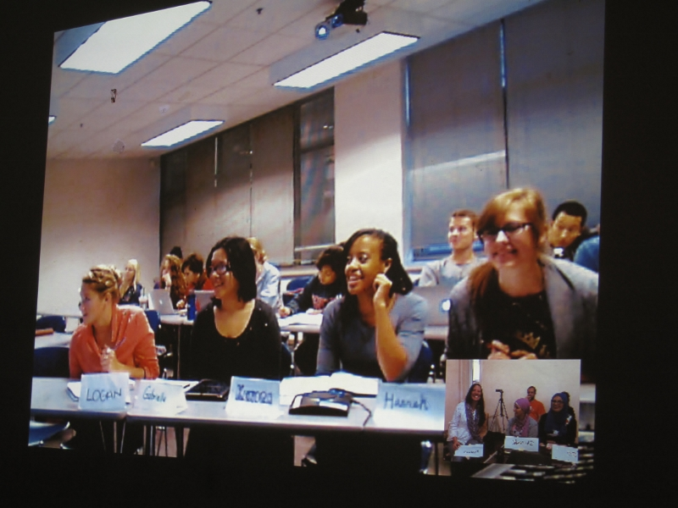
Lessons Learned
It’s the Relationships, not the Information
Notes:
We have unlimited access to all the information in the world, at our fingertips. You can google it. What adds value, and makes the information most meaningful, is how individuals, cultures, countries, intrepret and use the information. It’s understanding the users of information that is key. In other words, it’s the relationship, not the reading, that is important.
When we started working with students in Gaza, US students wanted to jump right in, asking about the war, bombings by Israel, and how they felt about it all. But when we, at the end, accidently found out that they knew hip hop celebrities, and did hip hop, they found an immediate connection, shared video clips, investigated that there was a palestinian hip hop social group on campus and sent video. That opened up the conversation. So now, I always get them to spend time first on relatiohship building. Its key in any group work.

Slide 32
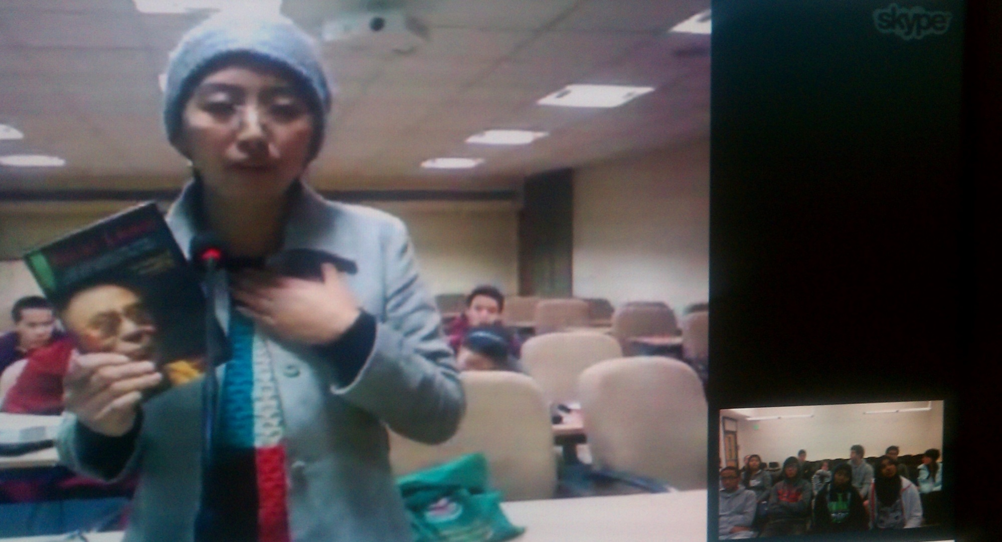
Lessons Learned
Pay attention to Power
Notes:
Power imbalance between teachers, students, increased by distance, grades. Still a problem
US Students want to do the task. India more focused on relationship building. So US students tend to get to the task, and play dominating leadership role. Need to bring this to the awareness of work. Help them understand how this happens at both micro and macro level. (years of US oppression tendencies as world power).
Get students to notice the little things: who sets agenda, who talks first, who talks longest, who asks questions, where is camera in relation to you (high, low angle shot, etc.

Slide 33
Lessons Learned
Real audience matters
Notes:
Why this motivates students
It’s a real audience, not just a professor.
So great if students are the teachers of each other, and prepare to do so. Authentic and motivating

Slide 34
“Few things are harder to put up with than the annoyance of a good example”
-Mark Twain
Notes:
Few things are harder to put up with than the annoyance of a good example.
At the risk of offending, I will offer a few more examples.
To give you a sense of the breadth of courses, and particular aspects.

Slide 35
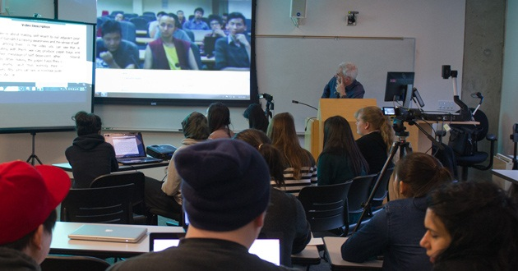
Course: Current Social Issues and Social Change.
3 classes, 88 pre-major students, mostly first-year
Notes:
Here are a few lessons learned from our UWB and Central University of Tibetan Studies course this fall, called “Social Movements through an international lens”.

Slide 36
Key Elements
Central U of Tibetan Studies, India, UW, USA
15 students- India, 30 students-US
9 weeks, 4 Video conferences
Facebook posts twice weekly,student-produced videos
5 Global Teams, 5 issues
Must take public action, based on cross-learning

Slide 37
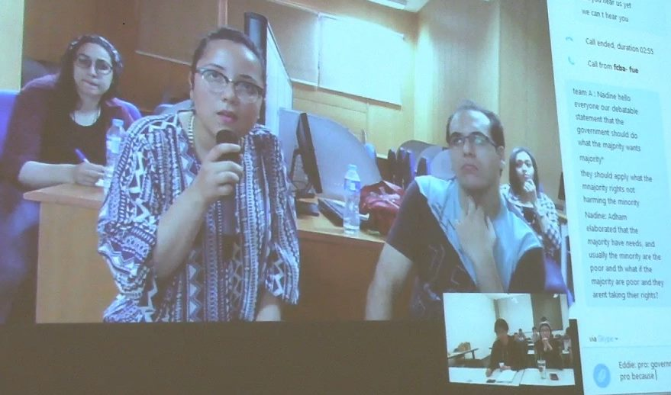
The Great Debates course
Notes:
Review this example of a recent course

Slide 38
Key elements
The Great Debates
15 students UW, 10 students FU
10 weeks
Skype : First by student teams, then at end, all class
5 teams of 5 students,
Discuss/debate 4 issues
Facebook intros, team video conf., debate videos posted.
Skills learned: research, communication, debate, virtual teamwork
Notes:
Review this example of a recent course
Students formed global teams, and discussed issues in on-line facebook forums, and live skype conferences of just their team members.
They wrote papers reflecting on their experience working in a global team, and challenges (both virtual and cross-cultural) of debating issues across countries).
Biggest challenges:
The logistics of virtual team work. Understanding different time zones and how it effected planning. Understanding different work and time commitments (some involved in high stakes tests, others had heavy work or extra-curricular commitments unknown to other country)
Understanding different points of view across cultures.
Interpersonal. How to “first seek to understand, and then, be understood”
Interpersonal: How to resolve conflicts (and the importance of relationship building first and on-going)
In addition to the above, they also learned specific content: Principles and practices of good debating, public speaking, how to research social issues and find credible sources, understanding group roles, stages of groups, group dynamics, team work, and specific content on key social issues and how they play out locally and globally.

Slide 39
Co-Creating Compelling Cause-oriented Videos
Notes:
We had small class, and formed 5 global teams, 3-4 people on a team (1-2 from each country, Egypt and US)
Purpose was to identify a common social issue and then co-produce a video about it, one issue per team.
Video was to be 3-4 min. long
10 weeks
Live video conference in the beginning and the end, to do intros, concluded with a Film Festival, live skype broadcast, critique and celebration. In between, students communicated asynchronous and synchronous as their team.
Videos produced on Fast Food restaurants and cultural impacts; University education and its value clashes; How societies care for and neglect children; the global impact of hip hop.
Show a brief clip from this youtube video on hip hop:https://www.youtube.com/watch?v=_XhJL1XhfA4

Slide 40
Key elements
5 Global teams of 2-3 students
Discuss and decide on a shared social issue
Co-Produce a 4 minute video per team
Two Skype conferences
Introductory
Concluding Film Festival
Notes:
See https://www.facebook.com/groups/1589843714592031/
View the WeVideo: The sterotypes of Egypt and reality video.
Or see: global hip hop https://www.youtube.com/watch?v=_XhJL1XhfA4

Slide 41
Why?
Huge impact on students and faculty
Reach the 90%
Global team work
Less costly
Enhance Diversity
Retention
Notes:
Review impact on self and his students
Become a better teacher by sharing strategies across cultures
Forces the teacher to be a learner right along with students because courses rely on students to engage, create content, self-assess
This reaches the 90% of students who never travel abroad in college
The Global Team Work is what students will be doing in most workplaces of today and tomorrow
The virtual connections, when done well, build real relationships across cultures, and change forever how you see yourself and those in another college, as happens when you travel abroad. It has many of the same impacts as travel abroad, but for a fraction of the cost
It emphasizes the strengths in having a diverse team, reinforcing that the best teams take advantage of what diversity brings. And it helps students generalize their cross-cultural experiences and lessons learned to both home and abroad. See Youtube 2 minute video of 3 youth from Somalia, Yemen and Djibouti: https://www.youtube.com/watch?v=29i2ziu1BpI
We know when students feel more engaged in school, it increases retention. These courses increase engagement.

Slide 42
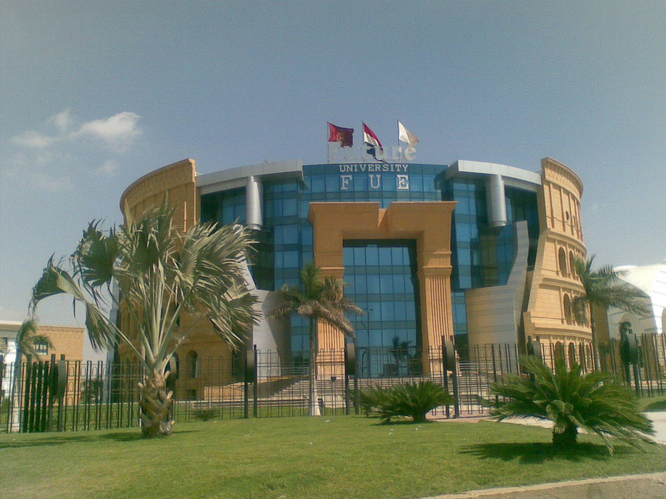
How?
Partner Identification
Institutional Support
Agreed Objectives
Agreed Activities
Notes:
How to get started
See Going Global Website for downloading the SUNY COIL planning guide for getting started. http://www.tukeinternationalconsulting.com/field-training.html
Identify a partner. Ask colleagues who they know. Look around campus for visiting scholars or past international visiting scholars. Look at who university is currently partnering with. Check out the international website for potential partners: http://uni-collaboration.eu/
Institutional support. Seek support from dept. and university from beginning. Promote what you are doing, help it build your university brand.
Agreed Objectives. Meet early and virtually with your partner. Discuss overall objectives, and find which ones overlap.
Agreed Activities. You don’t have to mirror exactly what you do in each classroom. Identify those activiites you want to share, and be sure you have a shared sense of how they are to go, what the desired outcomes are for both sets of students, and how you will mutually support the students.

Slide 43
“One drop of practice
is worth more than
an ocean
of theories”
Notes:
Now, let’s get busy and do a COIL course!
This quote comes from an etching on the outside of a university building at CUTS where I now coach faculty and work with students like these pictured here working on a team project. I could lecture to them about the elements of good group work, but unless they practice it, it does what my mom said about me sometimes….”it goes in one ear, and out the other.”

